Slide 1
Genome-wide Analysis of Groucho Function in Drosophila Embryogenesis
Michael Chambers

Slide 2
Gene regulation through concerted action of activators and repressors
On
Co-R
On
Off
A
R
A
Co-A
On
F
F
Co-R
Off
F

Slide 3
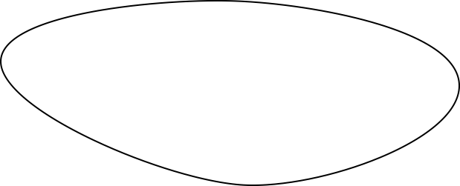
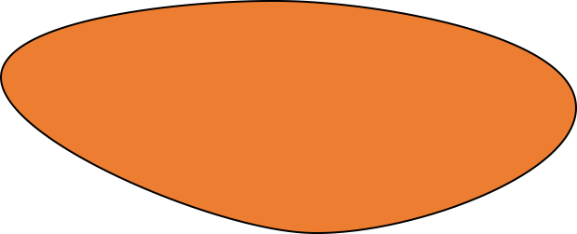
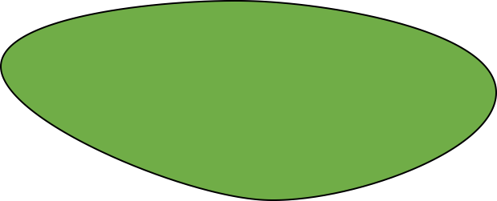
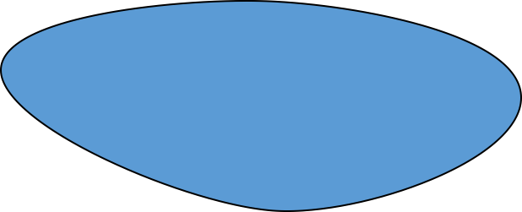
Spatial and temporal regulation of gene expression in development
On
A
Off
R

Slide 4
Morphogen gradients designate cell fate in embryogenesis
Low
Dorsal ectoderm
Embryo
Embryo
Cross-Section
Nuclear Dorsal
Neuroectoderm
High
Mesoderm

Slide 5
Groucho is a co-repressor integral to Drosophila development

Slide 6
Groucho is recruited by multiple sequence-specific factors
Dorsal-ventral patterning
Dorsal
Brinker
Ind
Vnd
Anterior-posterior patterning
Segmentation
Hairy
Runt
Even-skipped
Odd-skipped
Sloppy-paired 1
Engrailed
Knirps
Goosecoid
Terminal patterning
Capicua
Huckebein
Notch signaling
Su(H) E(spl)

Slide 7
Multiple potential mechanisms of Gro-mediated repression
Seikya and Zaret, 2007
Zhang and Emmons, 2002
Cai et al, 2003
Figures Turki-Judeh and Courey, 2012

Slide 8
Outline
A genome-wide survey of Groucho in the early embryo
Identifying components of the Groucho gene regulatory network
Groucho regulation and RNA PolII stalling

Slide 9
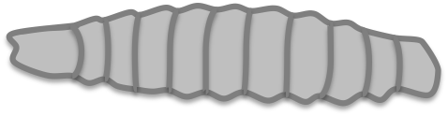

Genomic scale analysis of Groucho’s functions in early fly development
Embryo
24 hr
Larva
4 days
Pupae
5 days
Adult
RNA-seq
Nascent-seq
ChIP-seq
mRNA accumulation
pre-mRNA profiling
Groucho binding
Notes:
nascent-seq: Distribution of ternary elongation complexes
----- Meeting Notes (5/30/13 12:52) -----
Genome-wide instead of genomic scale
24 hr embryogenesis
Pupal 5 days ?
Histone marks under chip-seq

Slide 10
Groucho is recruited to thousands of sites throughout the genome
4 – 6.5 hr
6.5 – 9 hr
1.5 – 4 hr

Slide 11
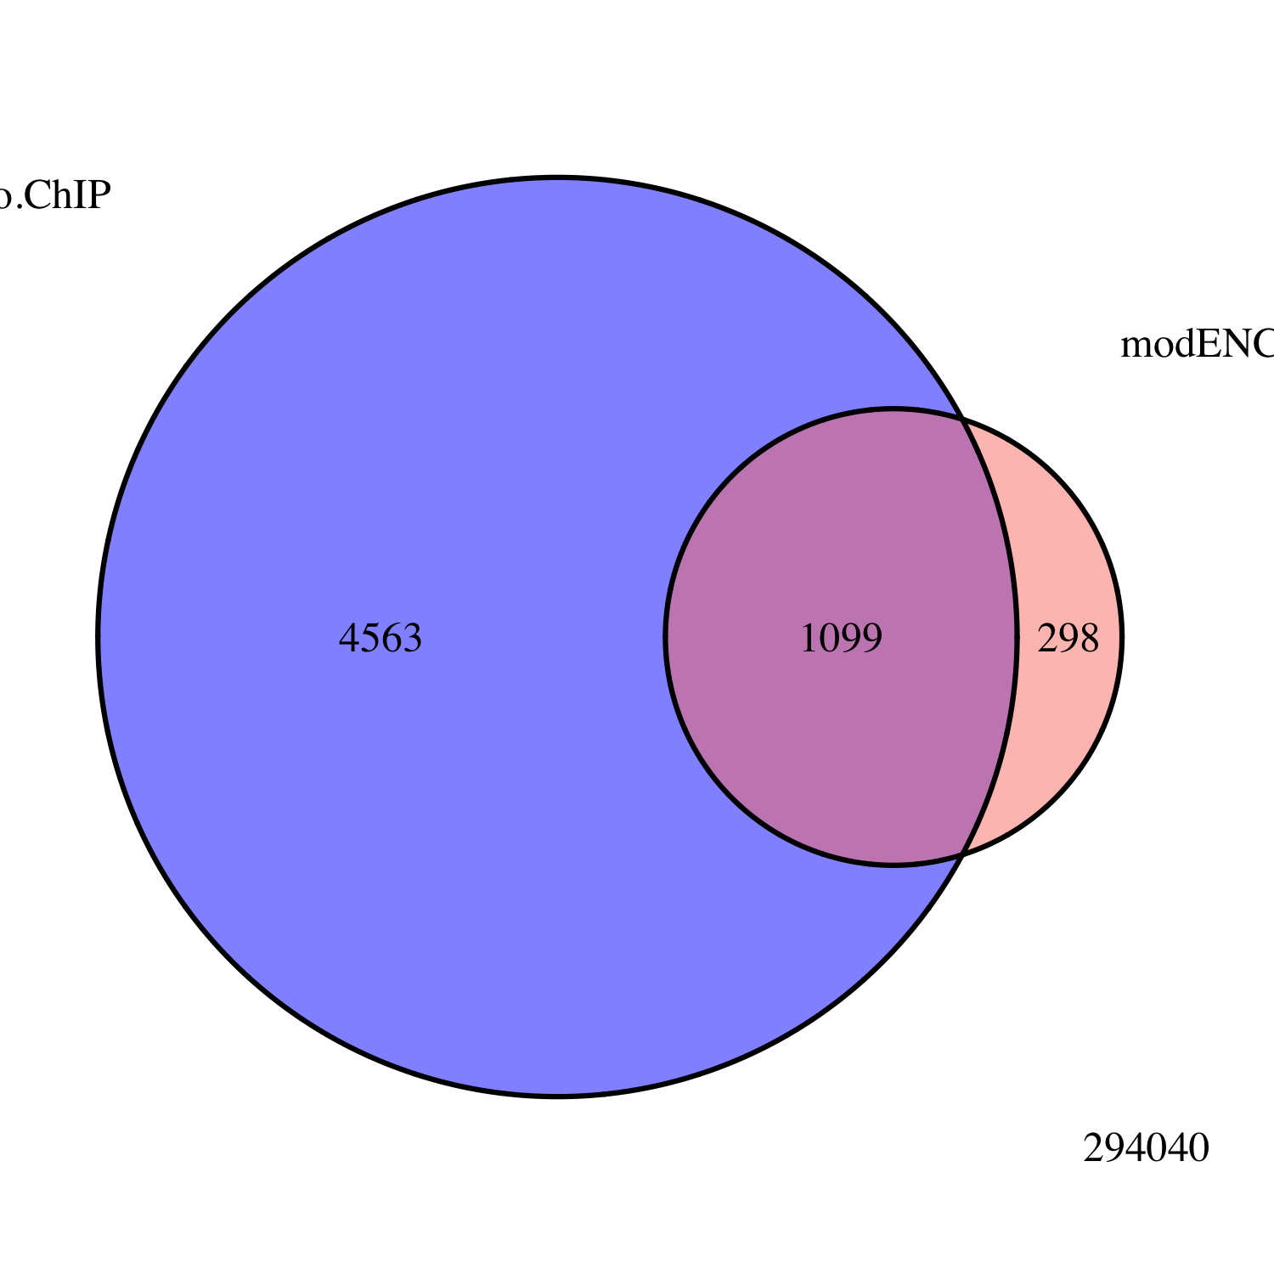
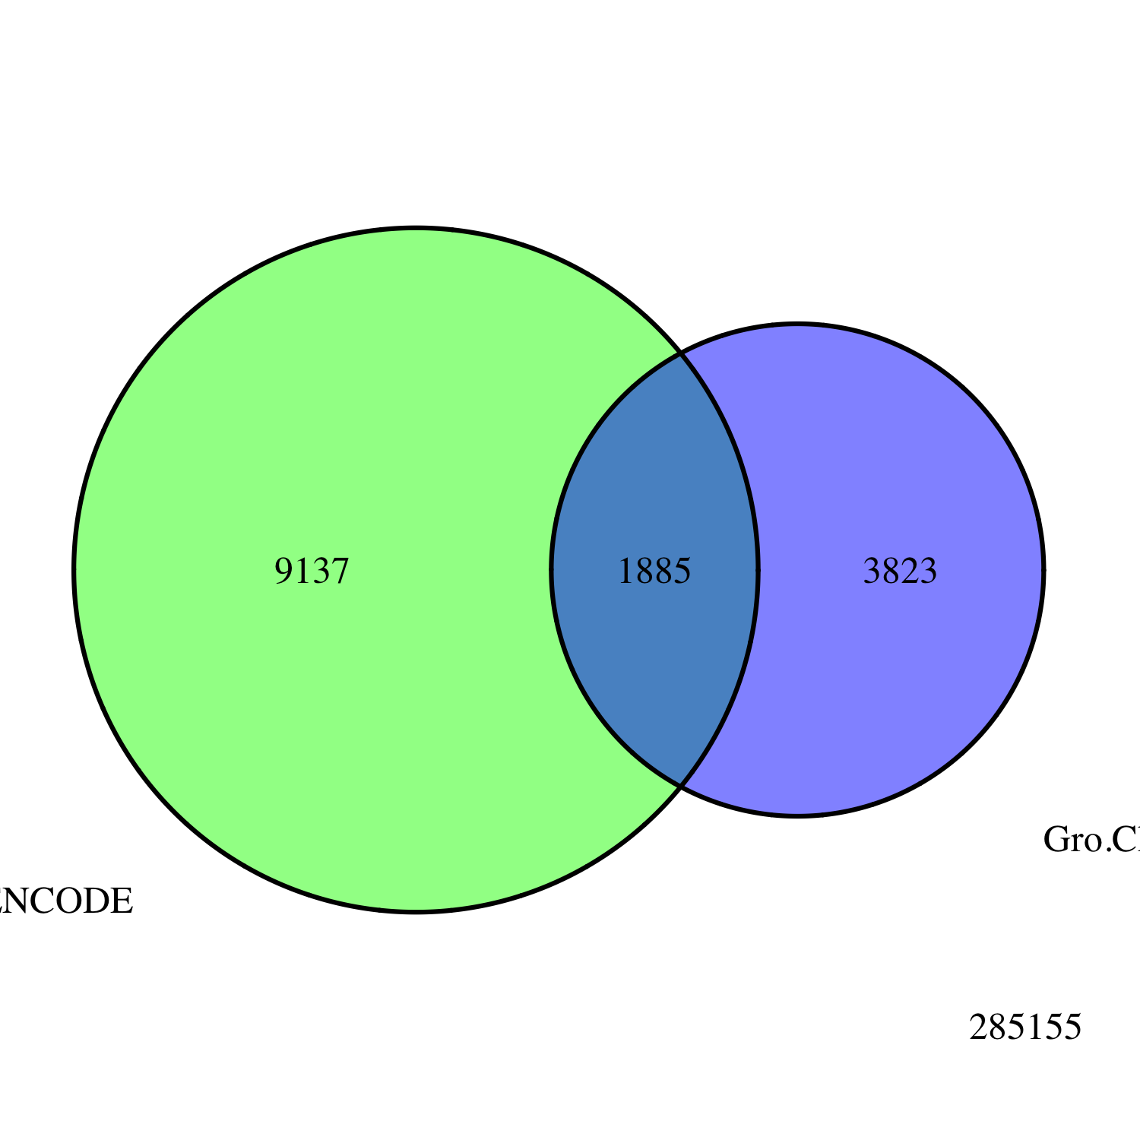
Embryo
Gro ChIP-seq
All Peaks
modENCODE
Embryo
Gro ChIP-chip
Embryo
Gro ChIP
All Peaks
modENCODE
White Pre-Pupae
Gro ChIP-chip
3823
1885
9137

Slide 12
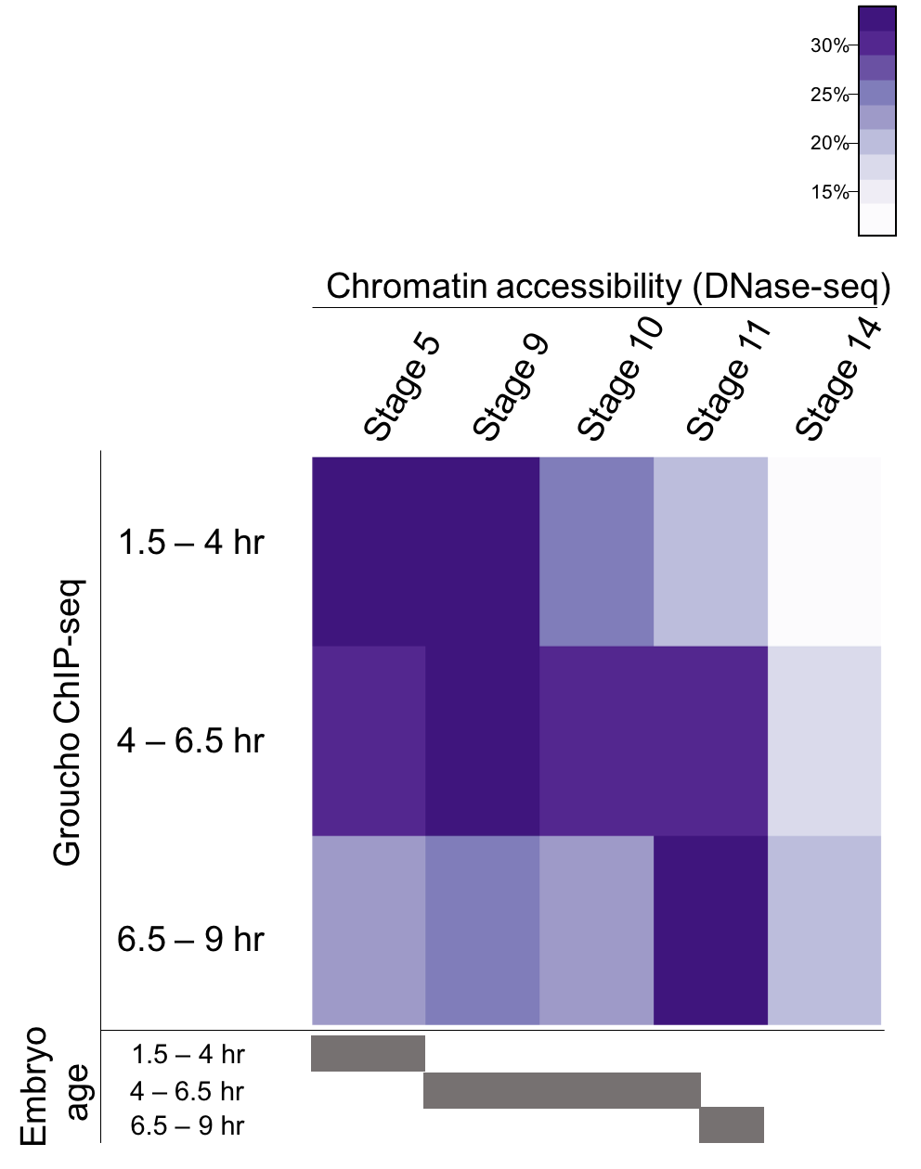
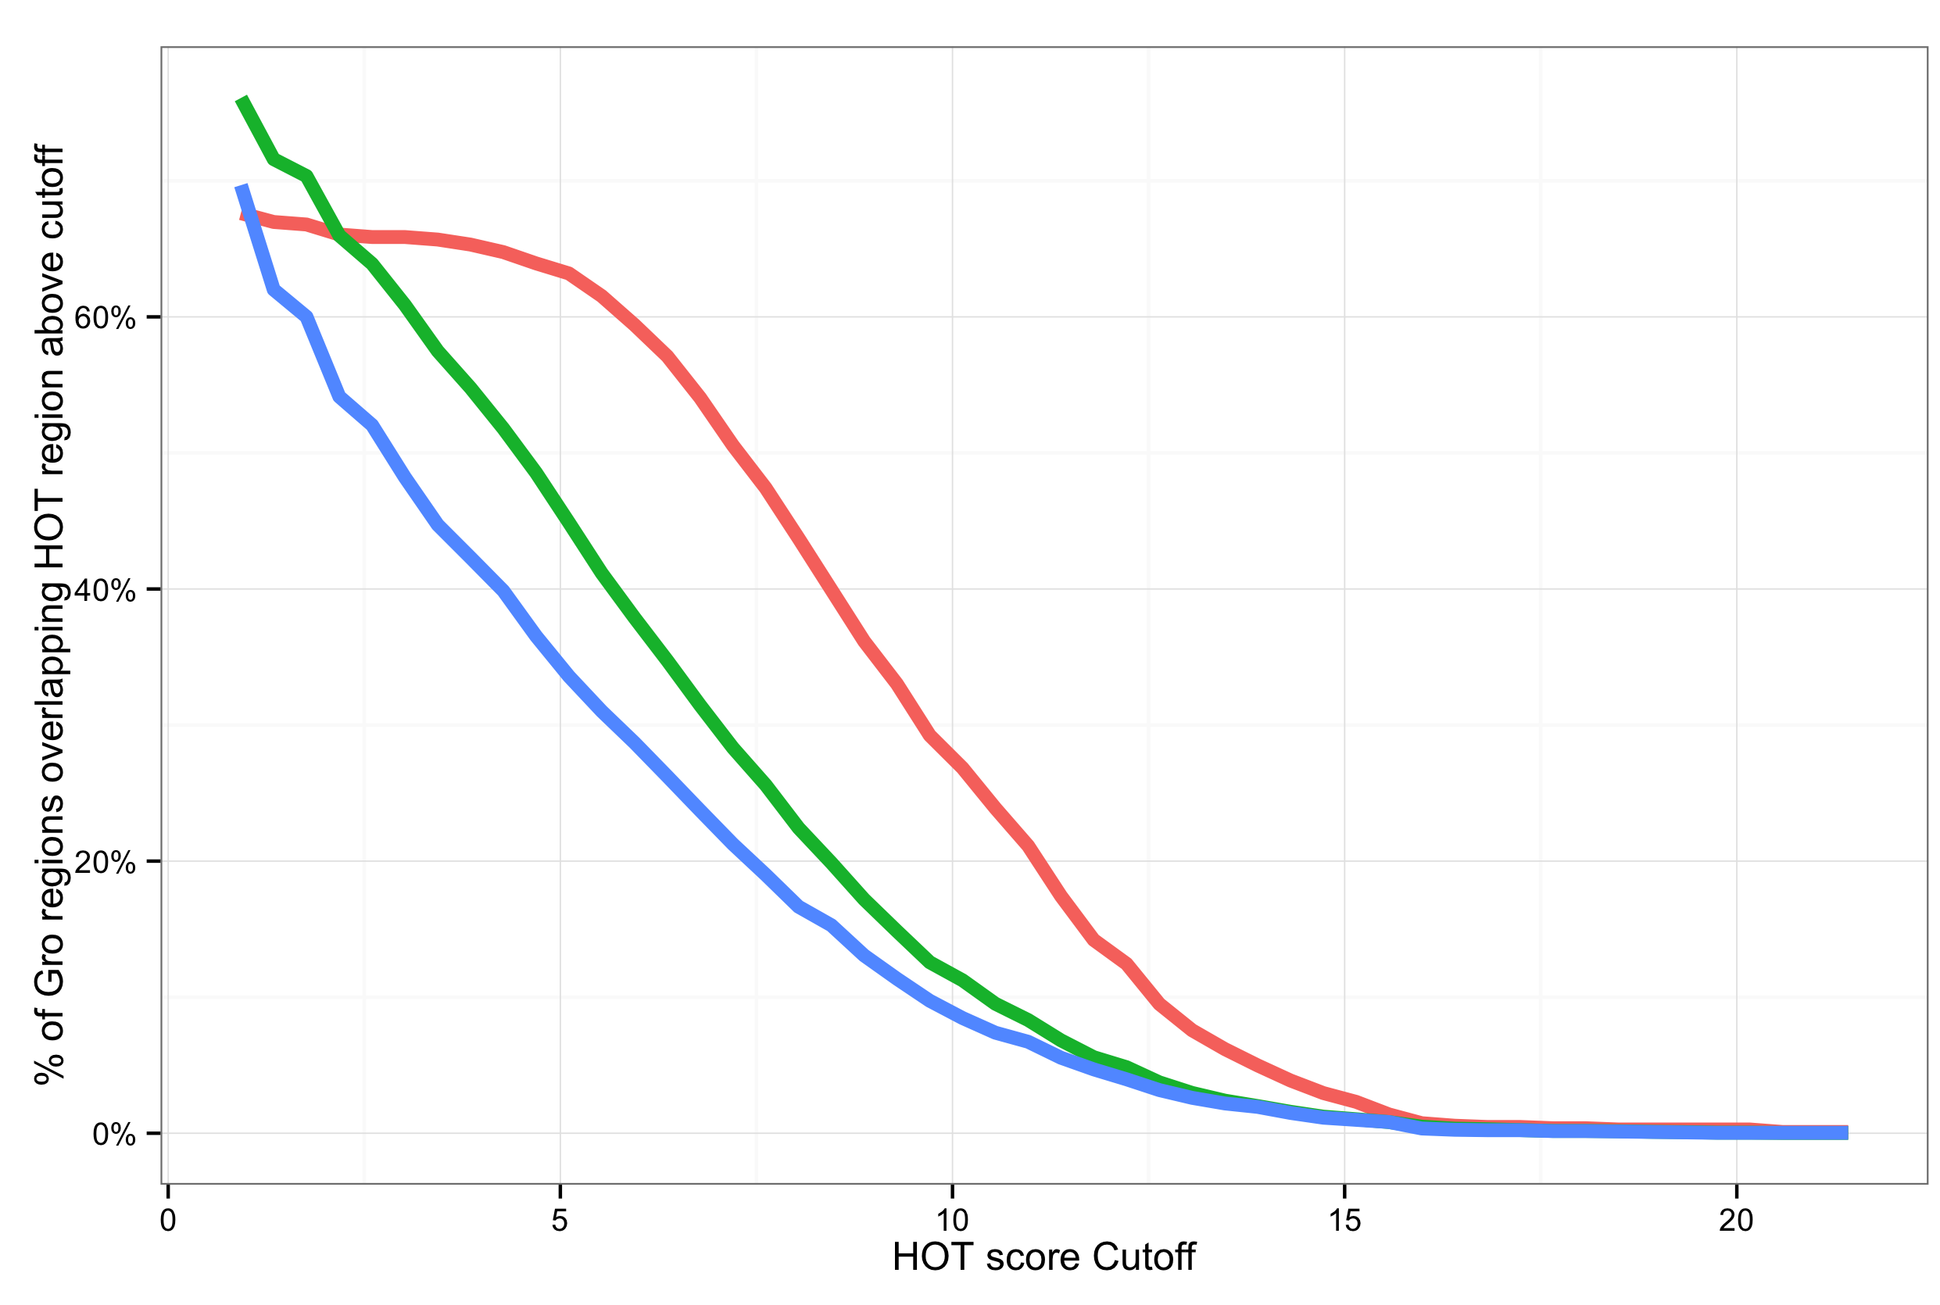
Gro is frequently recruited to areas of high TF density

Slide 13
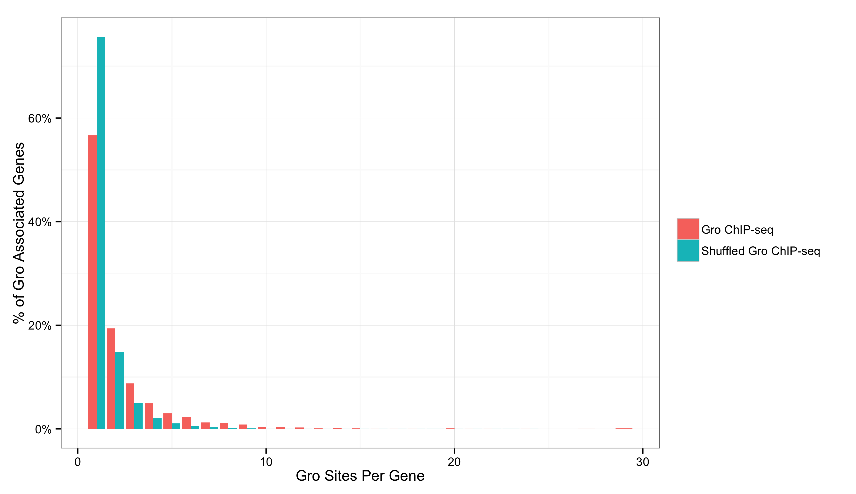
Binding to genes is enriched for multiple peak clusters
1
2
3
4
5

Slide 14
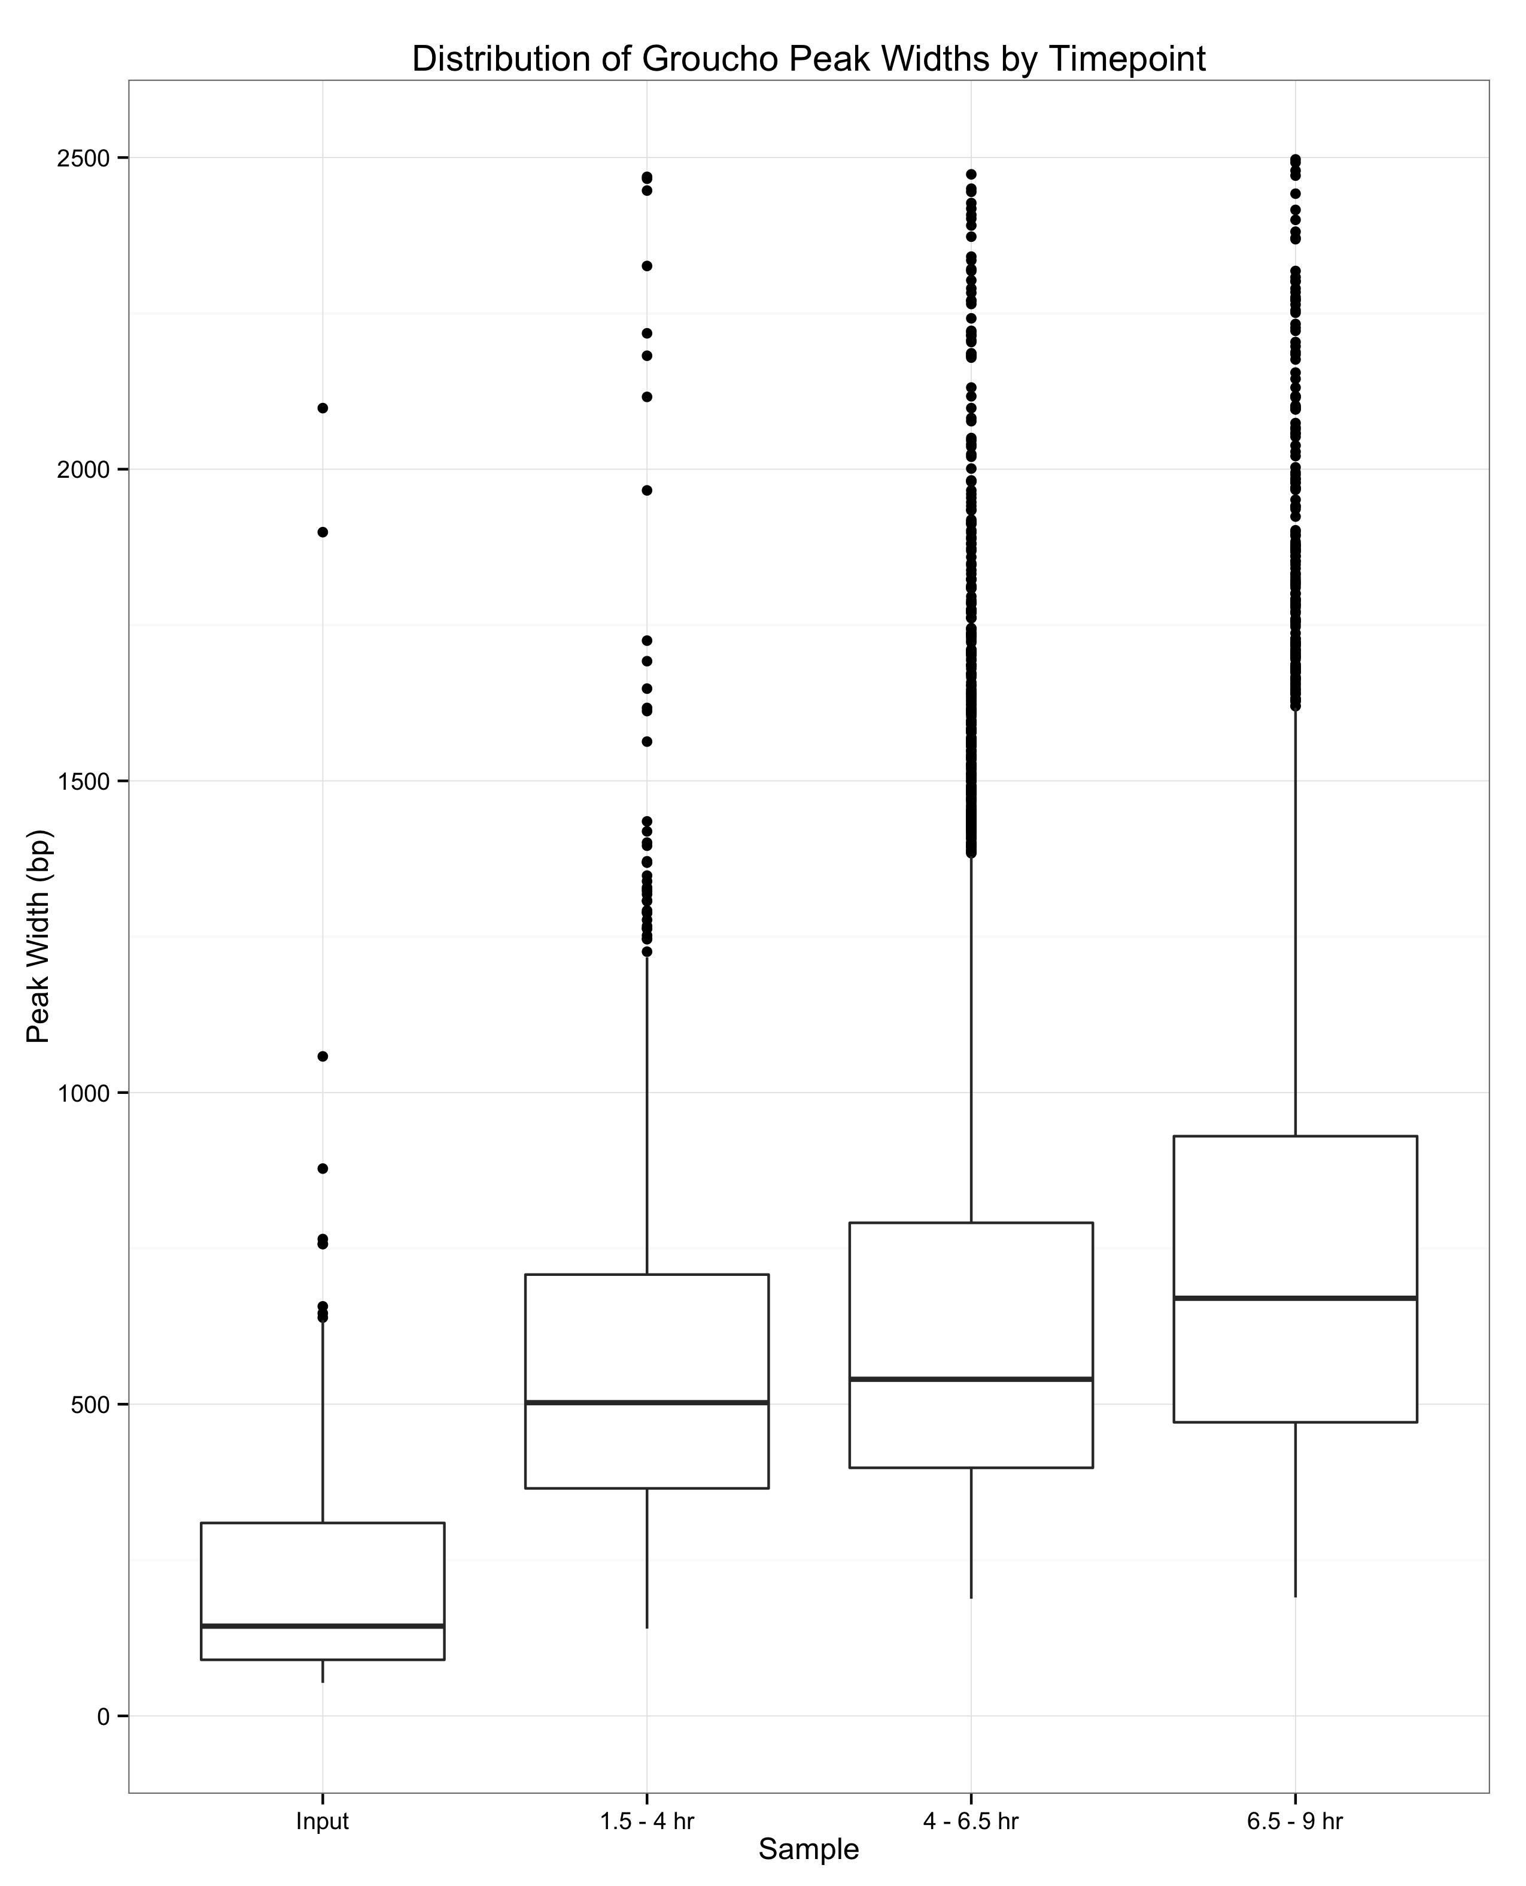
Gro binding is not indicative of spreading
2500 -
2000 -
1500 -
1000 -
500 -
0 -
1.5 – 4 hr
4 – 6.5 hr
6.5 - 9 hr

Slide 15
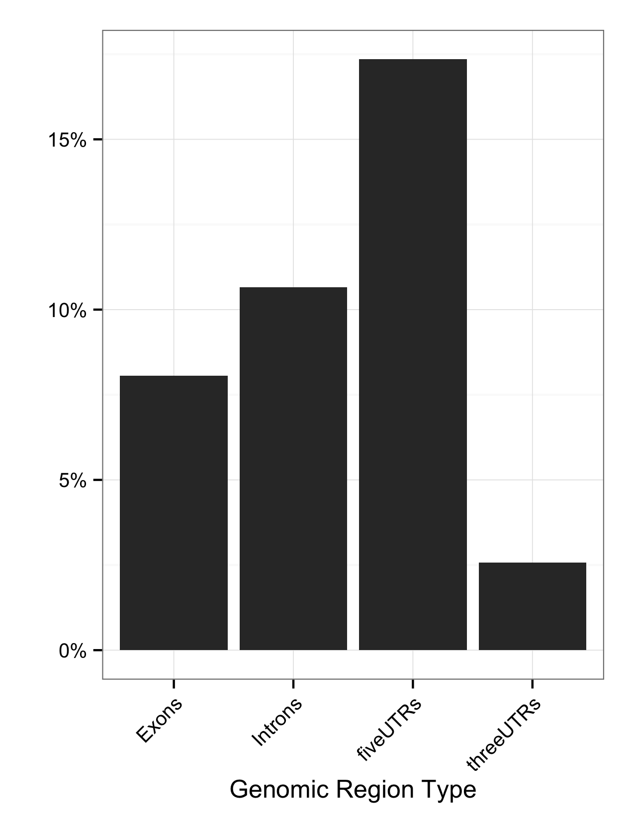
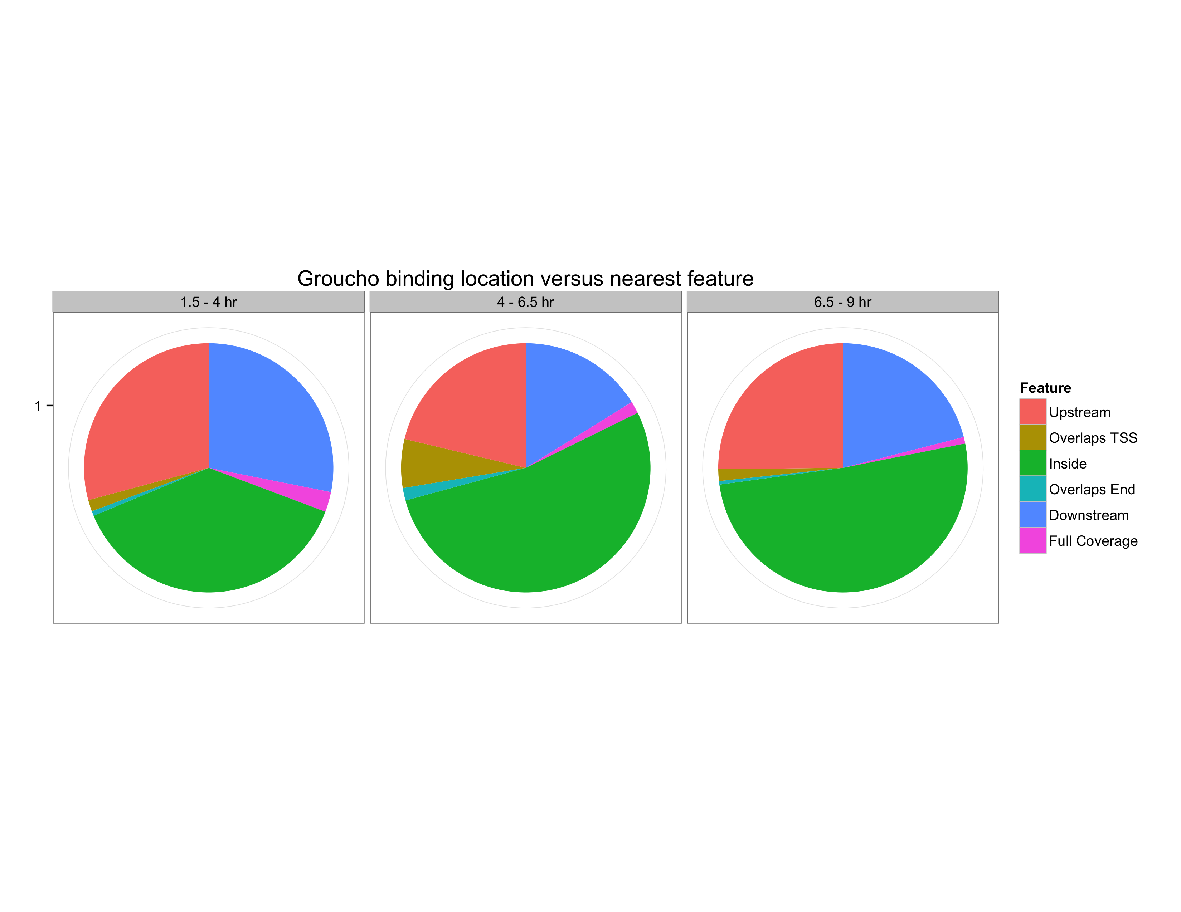
Gro binding is enriched within 5’ segments of genes
Fraction of Gro binding sites
Feature length normalized

Slide 16
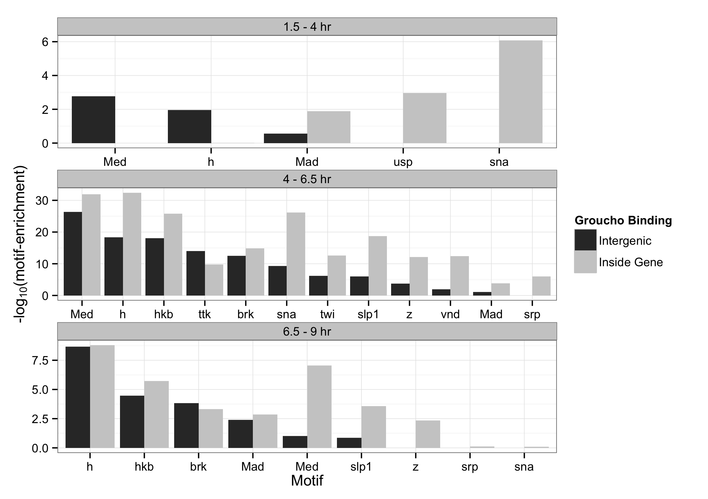
Binding sites are enriched for motifs of Gro-interacting factors

Slide 17
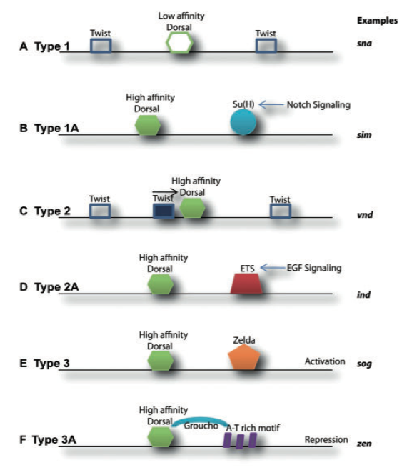
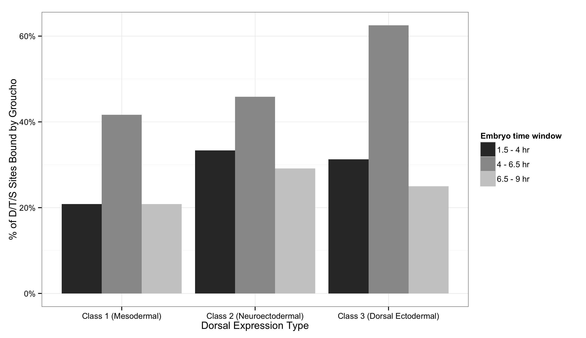
Gro is found at all classes of Dorsal binding site
Chopra and Levine, 2009

Slide 18
Outline
A genome-wide survey of Groucho in the early embryo
Identifying components of the Groucho gene regulatory network
Groucho regulation and RNA PolII stalling

Slide 19
Integrating Gro binding and transcriptome data in embryos
All expressed genes
All expressed genes
Responsive in gro gain- and loss-of-function embryos
Calculate “Gro occupancy score”
Internal or adjacent Gro binding
Define occupancy score cutoff from response curve
Gro dosage responsive target genes
Gro occupancy score
target genes

Slide 20
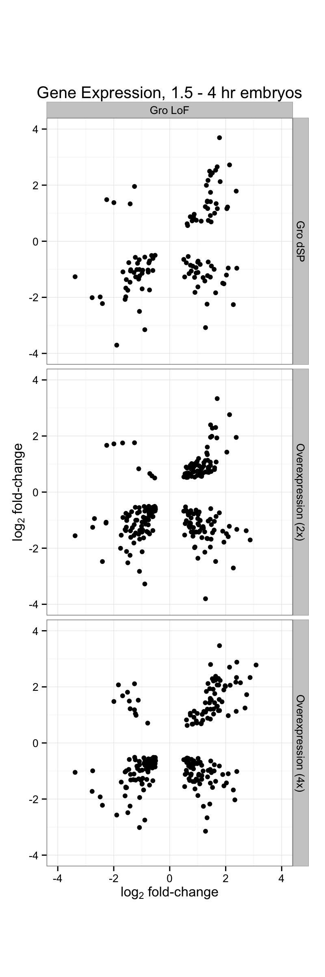
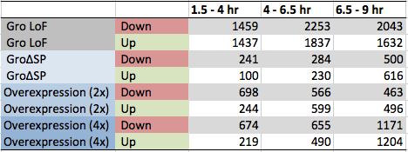

Slide 21
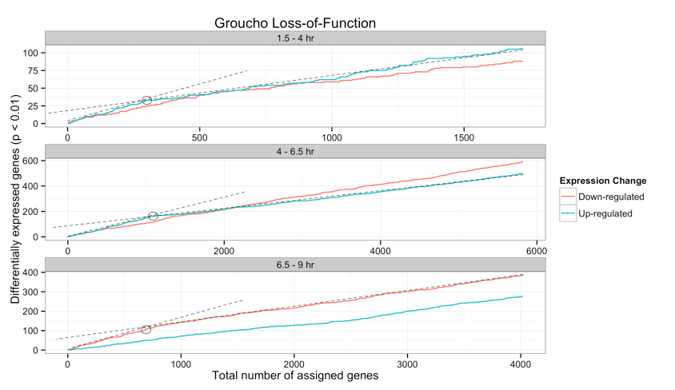
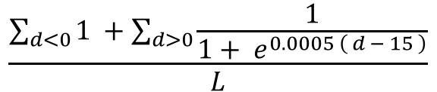
$$\frac{\sum_{d<0}{1 }+\sum_{d>0}{\frac{1}{1+ e^{0.0005 \left( d − 15 \right)}}}}{L}$$
Gro-occupancy-score =

Slide 22
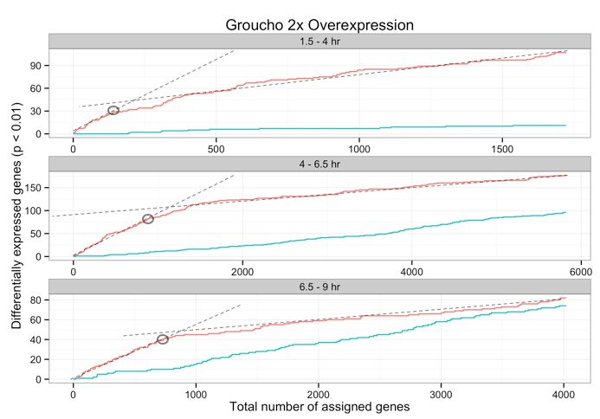
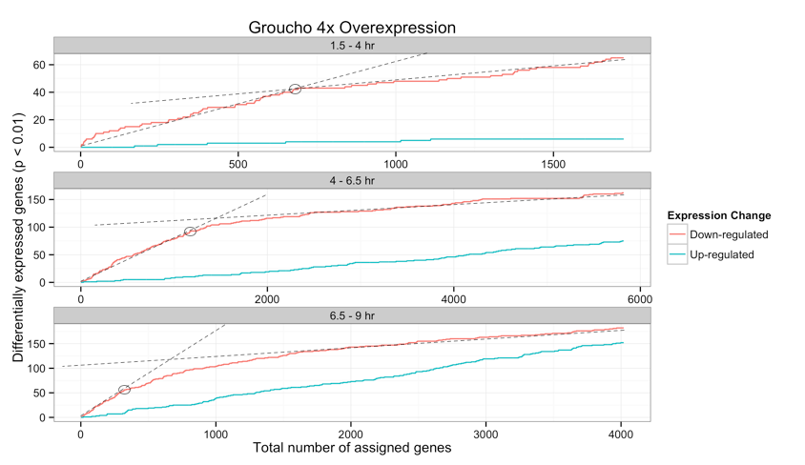

Slide 23
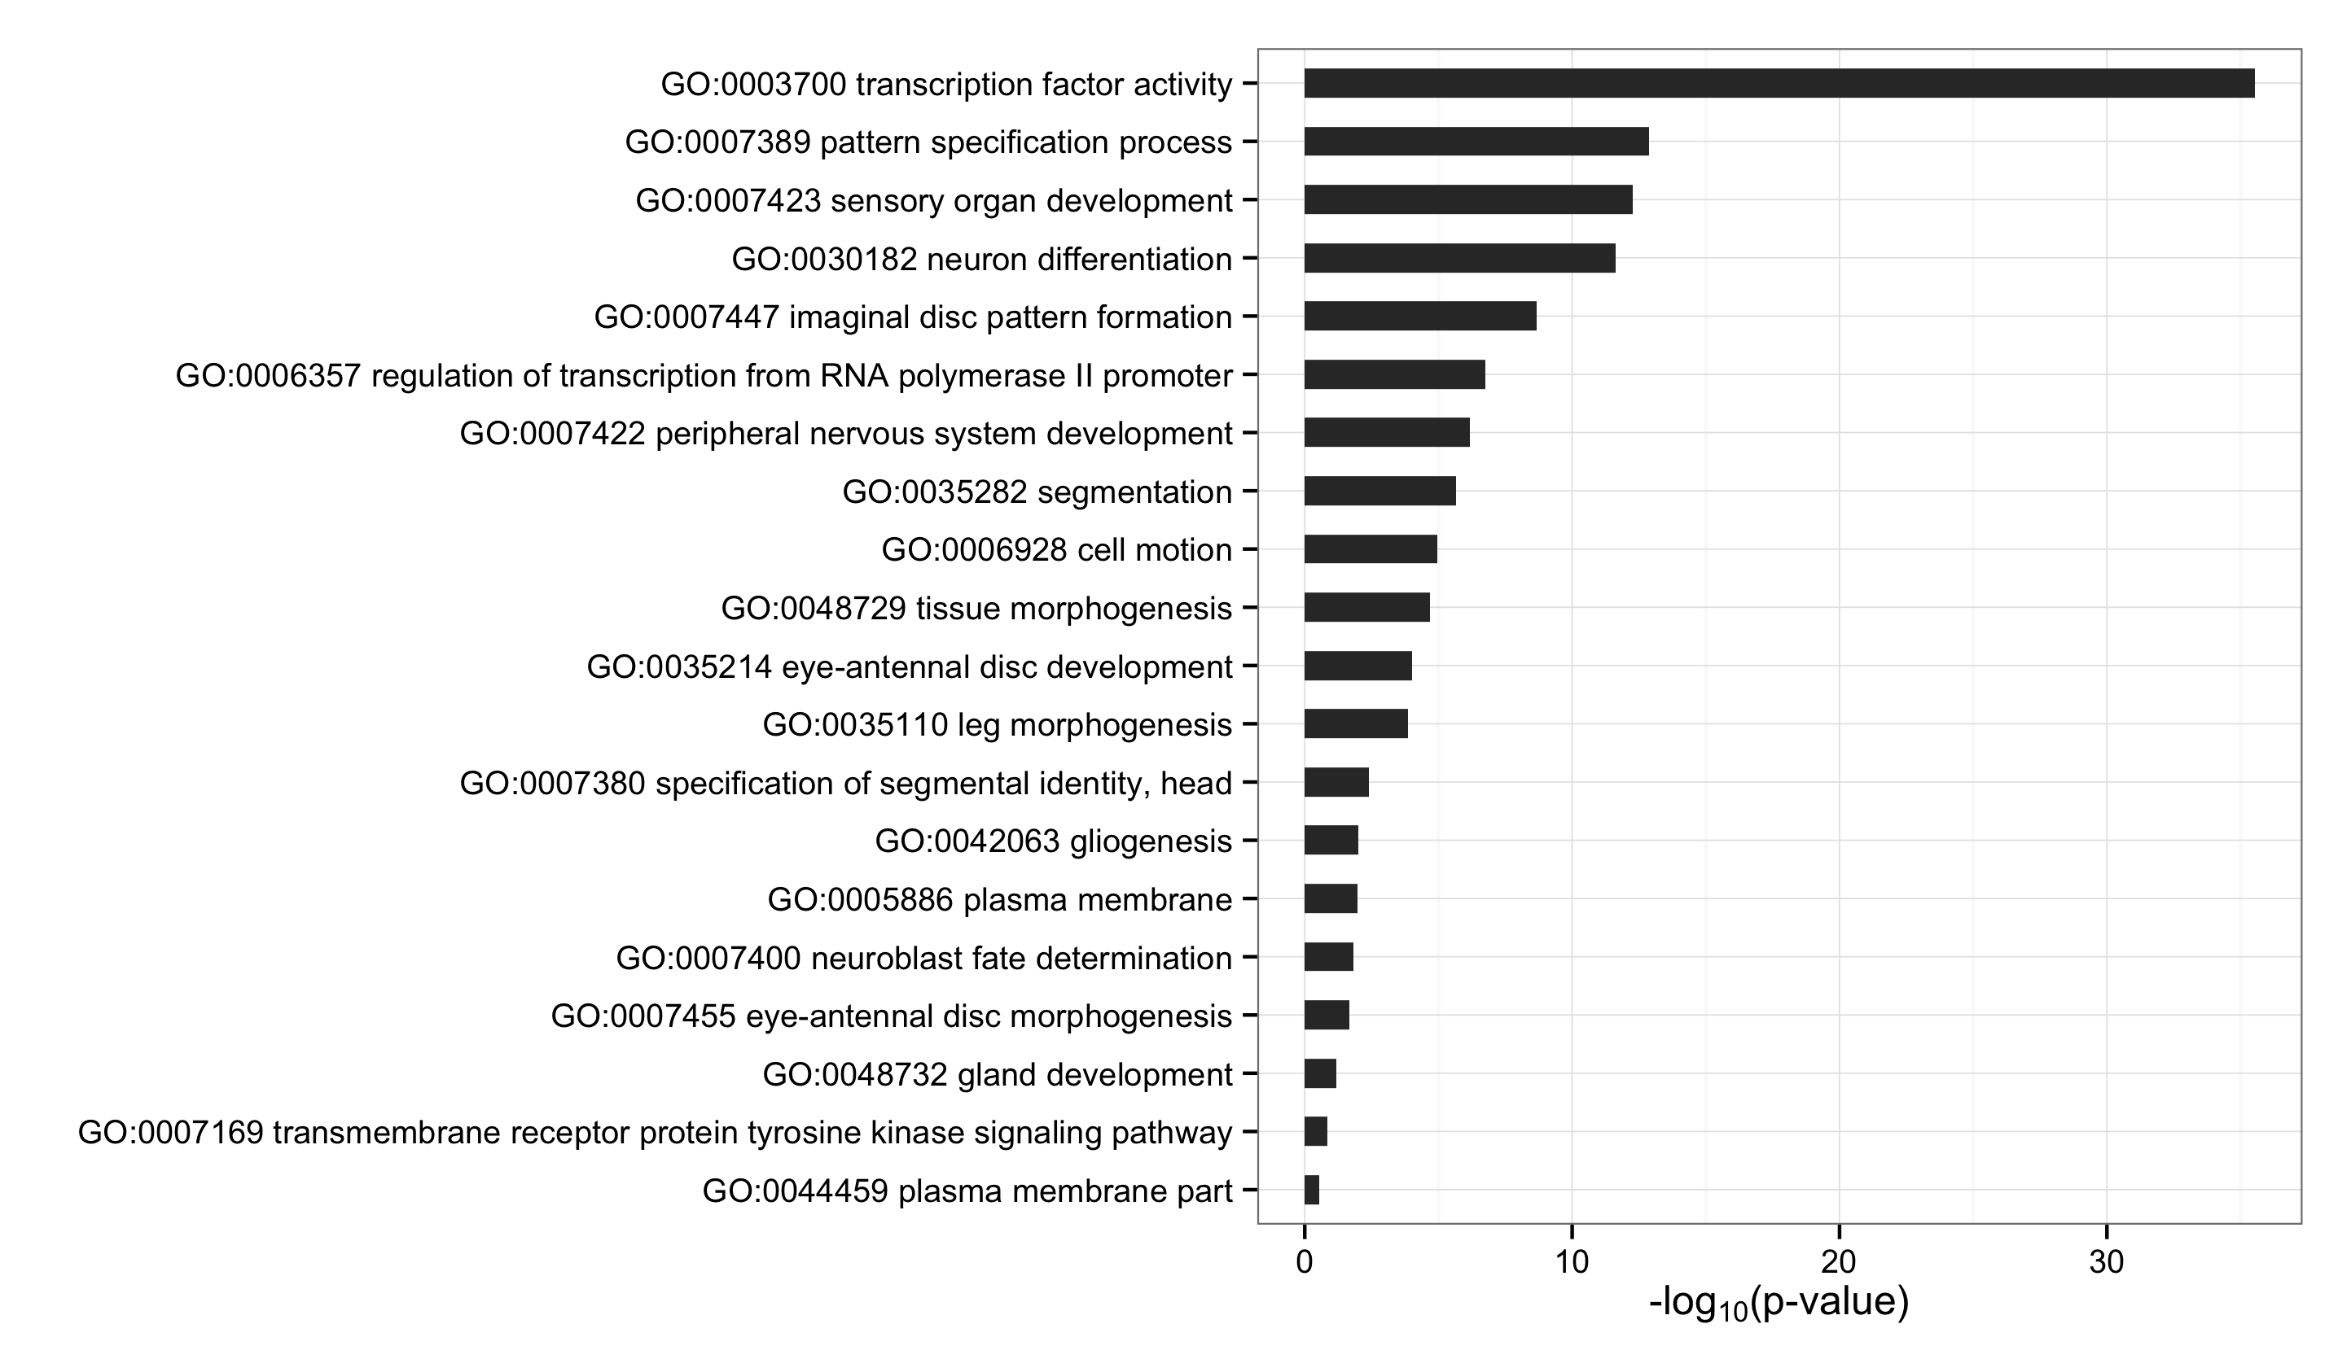
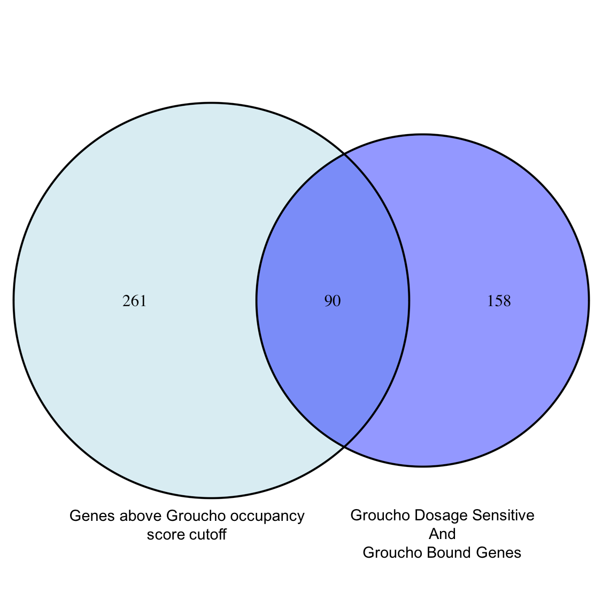
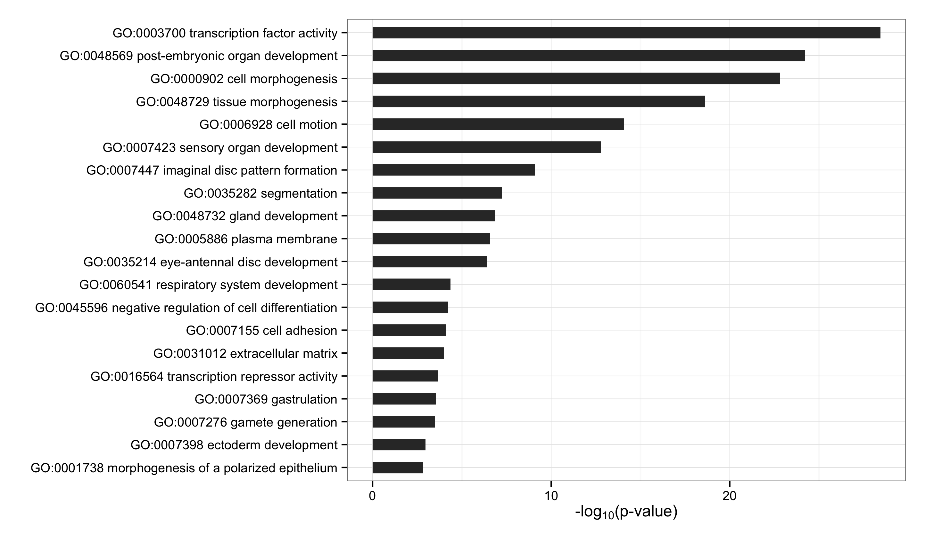
Gro Targets by Dosage Response
Gro Targets by Occupancy Score

Slide 24
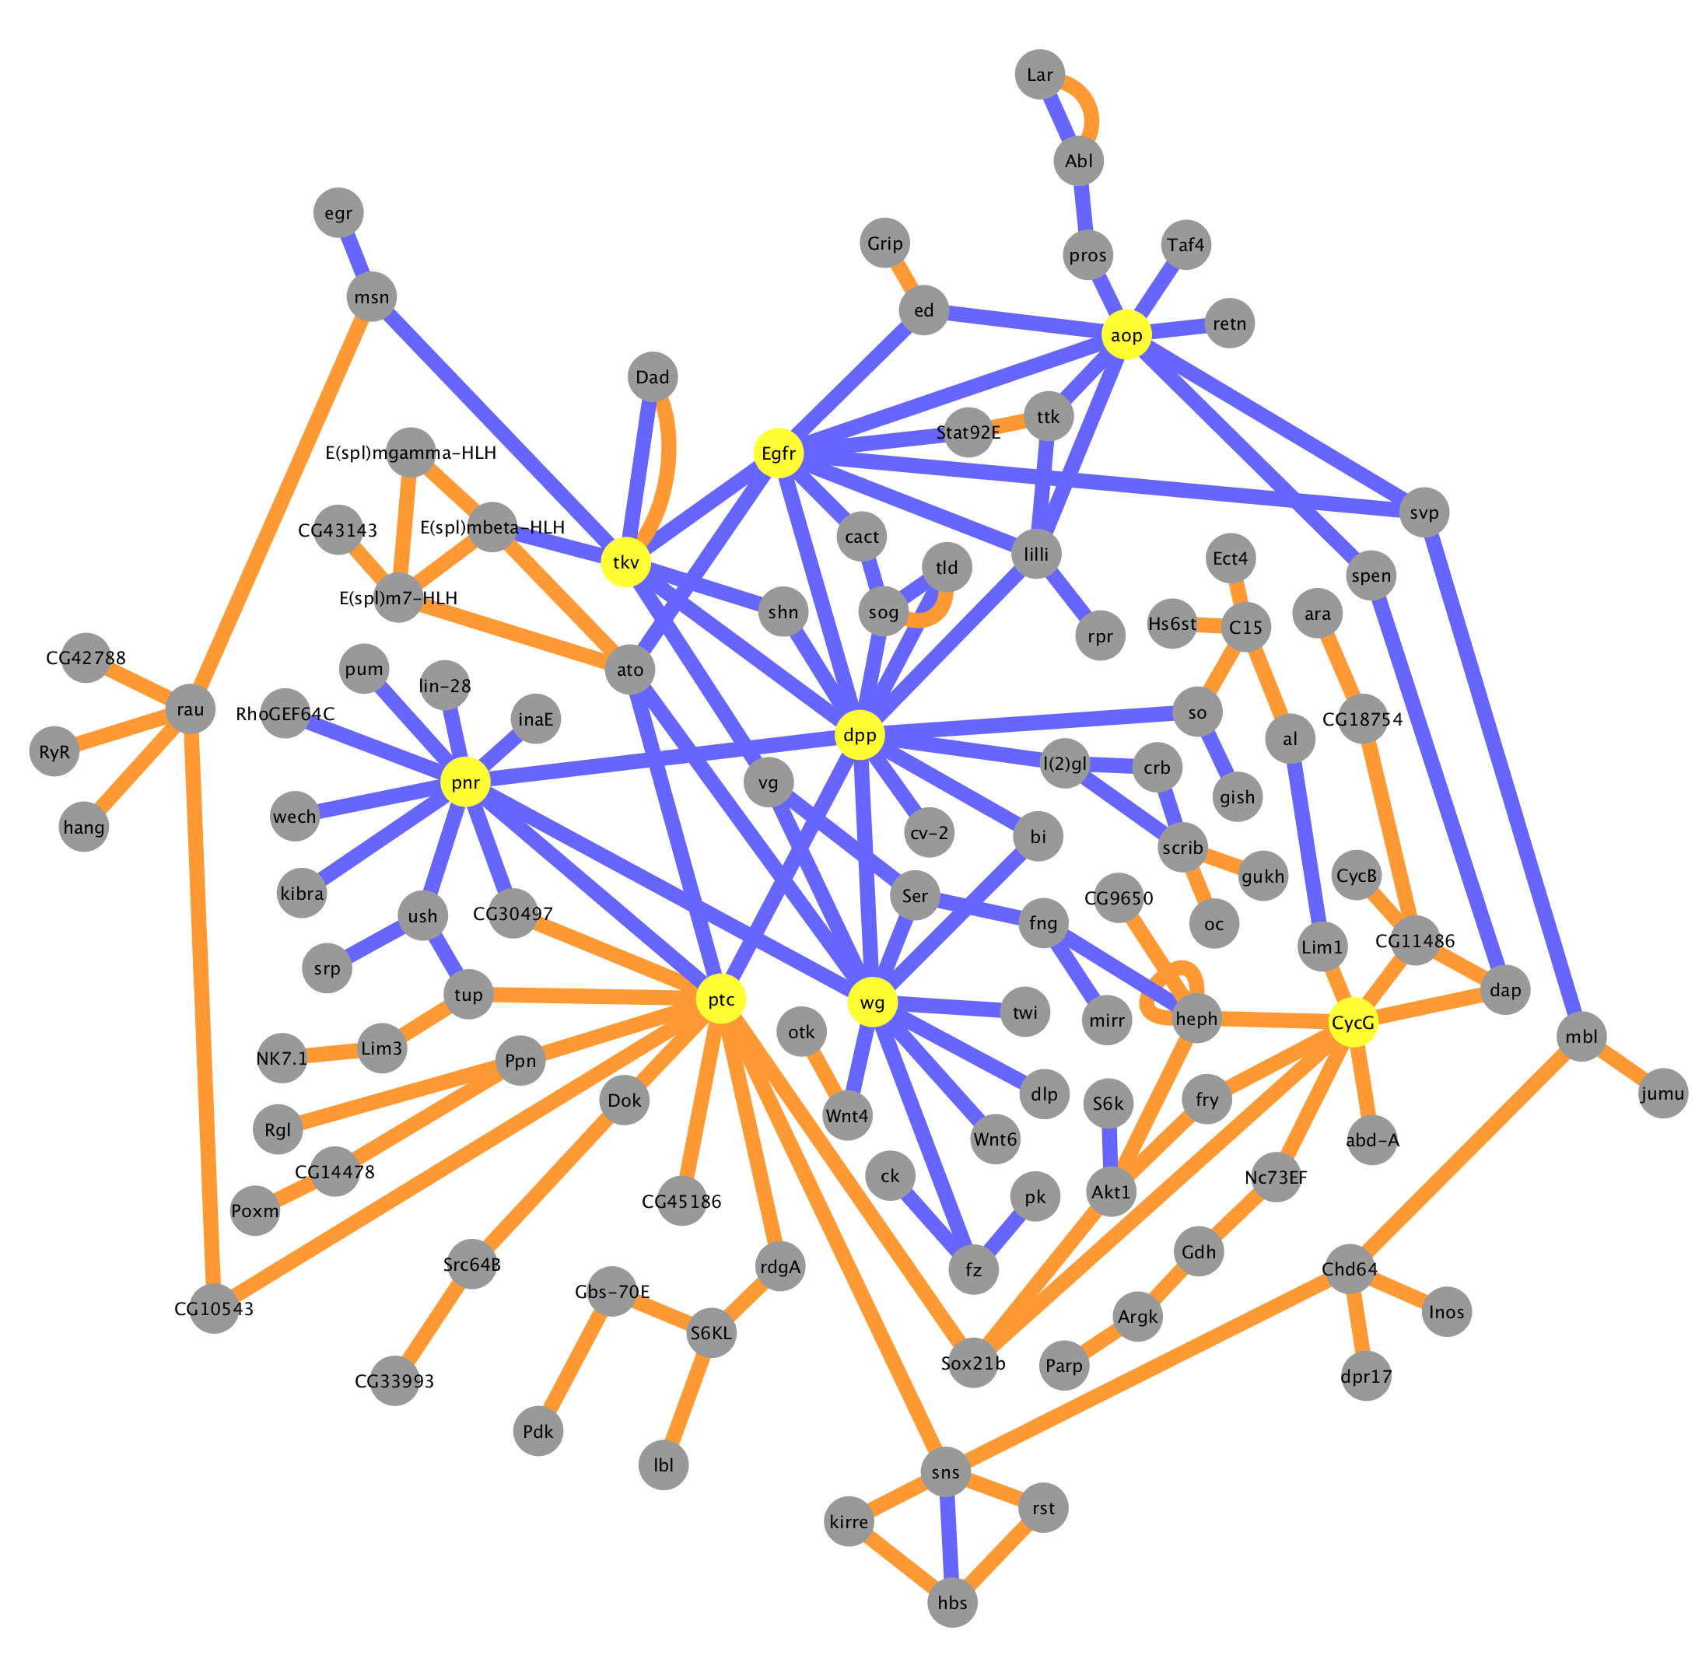
Gro Targets by Occupancy Score
Physical interaction
Genetic interaction

Slide 25
Outline
A genome-wide survey of Groucho in the early embryo
Identifying components of the Groucho gene regulatory network
Groucho regulation and RNA PolII stalling

Slide 26
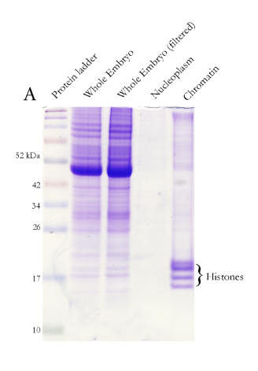
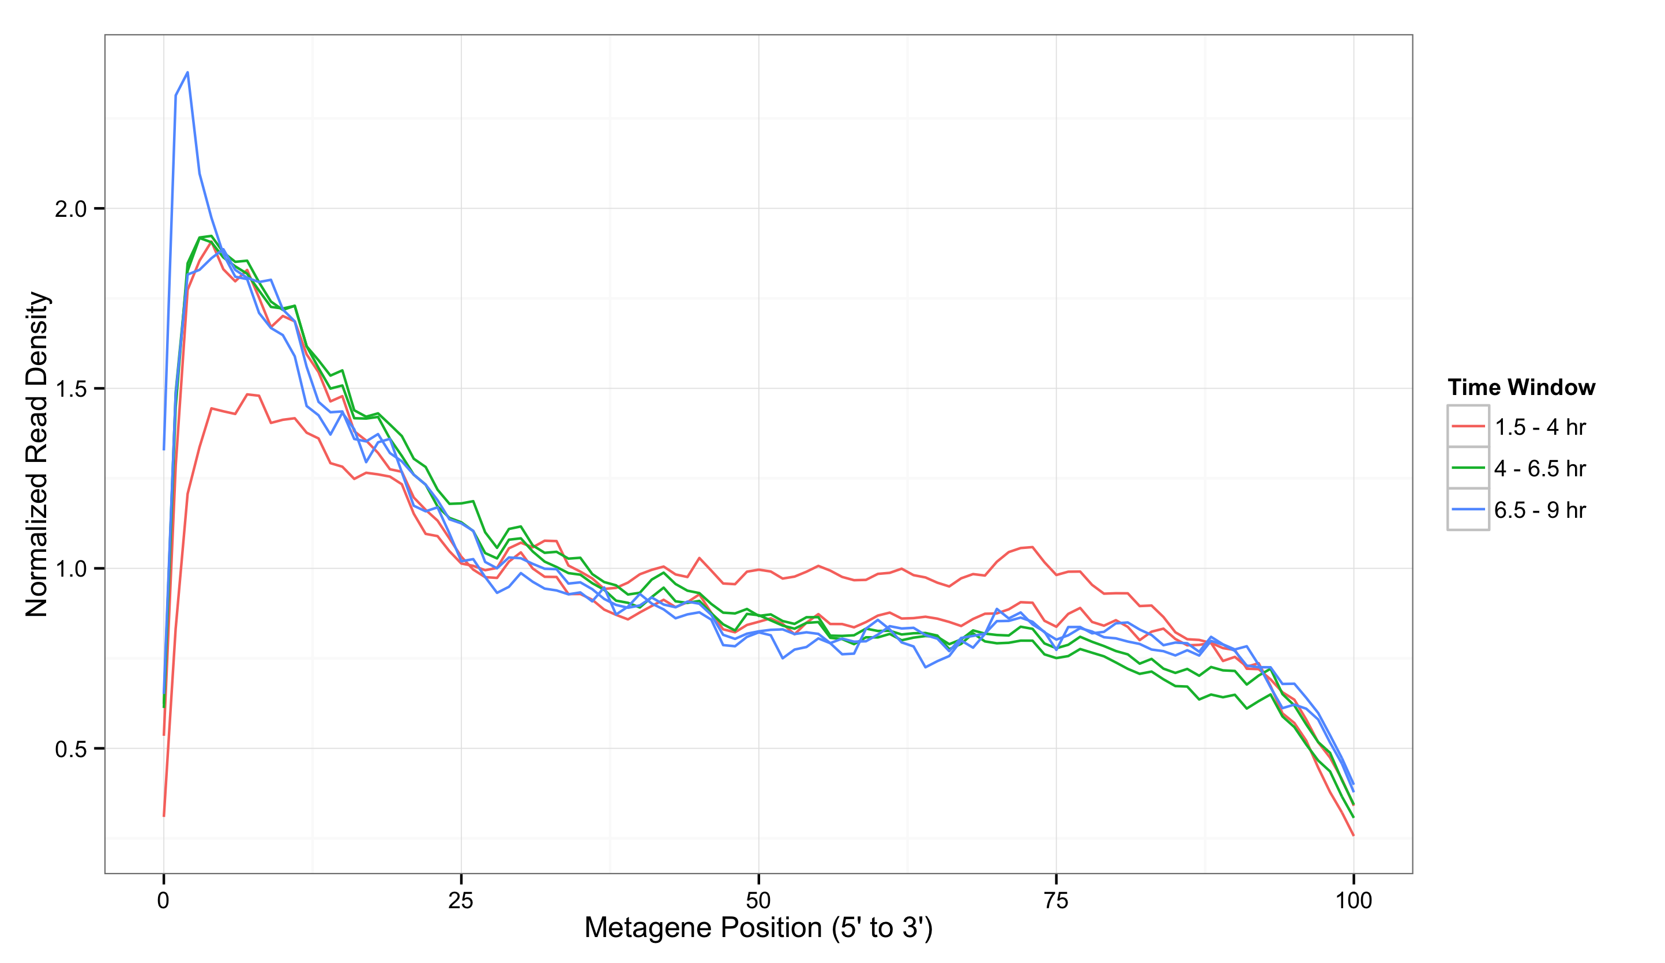
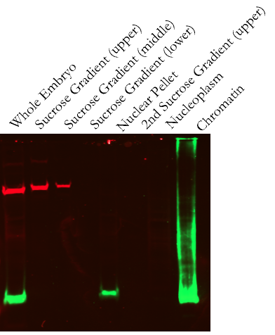
Isolation of nascent pre-mRNA
α-tubulin
α-H3

Slide 27
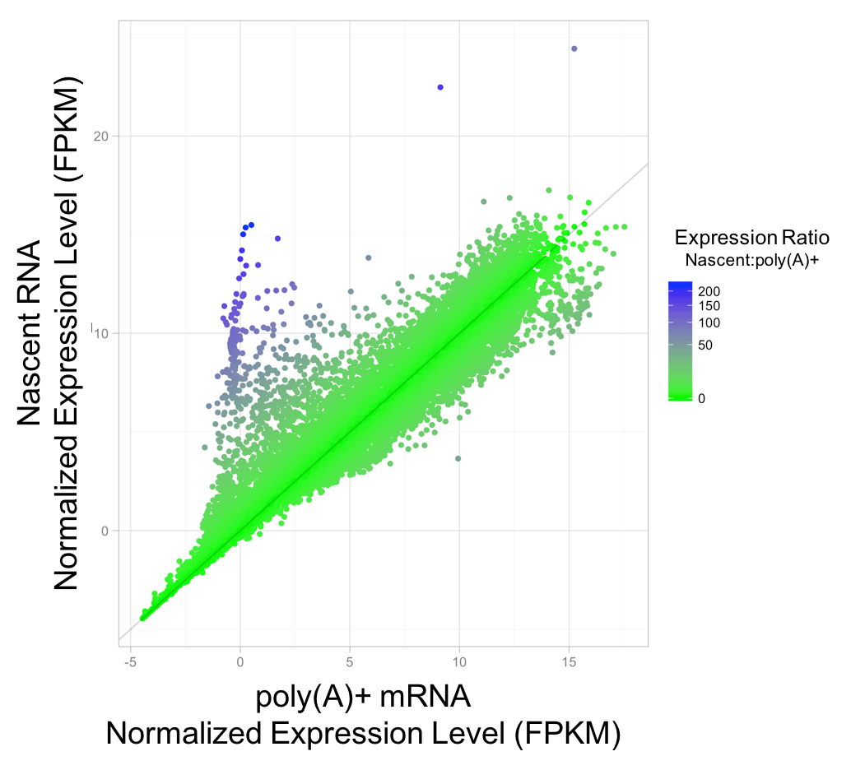

Slide 29
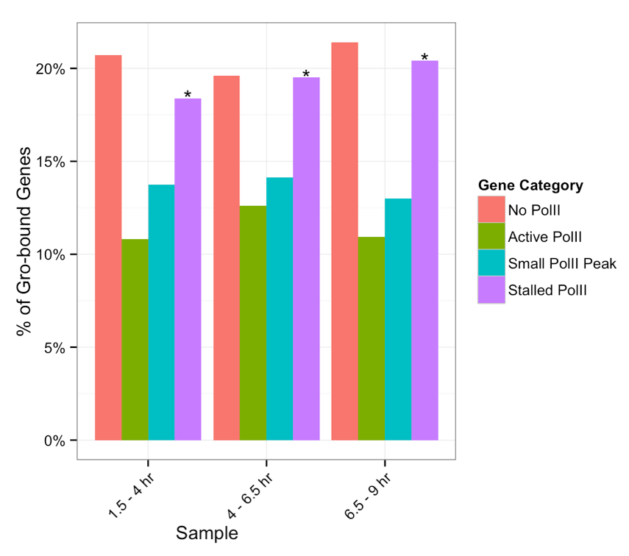
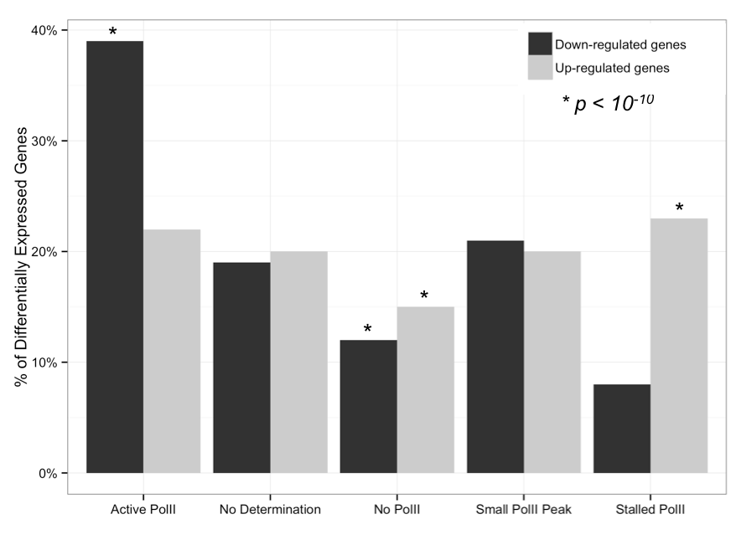

Slide 30
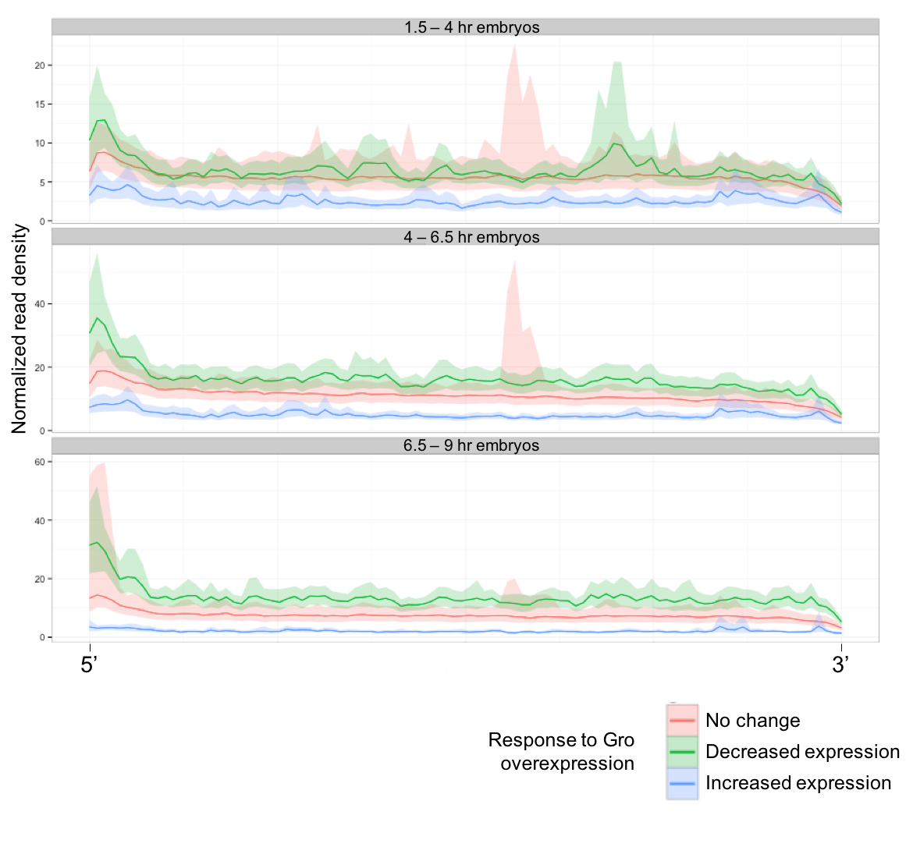

Slide 31
Conclusion

Slide 32
Acknowledgements
Courey Lab
Albert Courey
Joseph Cao
Kenny Chen
Mitchell Kim
Pak Kwong
Wiam Turki-Judeh
Tom Yau
Committee
Dr. James Bowie
Dr. Michael Carey
Dr. Catherine Clarke
Dr. Volker Hartenstein
Collaborators
Sean Gallaher (Merchant Lab)
Kelvin Zhang (Zipursky Lab)

